Slide 1
INVESTMENT CASE STUDY SUBMISSION
Group Name:
Balaji Ramasamy.
Bhumit Trivedi.
Mohandas Amarnathan.
Raunak Mukhia.

Slide 2
Abstract
This presentation is for learning the trends for investment in top Sector Companies of English speaking nations for Spark Funds. The investment data used for analysis is taken from site "crunchbase.com". The analysis will reveal where majority of investors are investing. Based on the findings the Spark Funds will be able to find the best suitable investment for their bracket which is of $ 5 to 15 MM at one go. The Goal of the analysis has been to find countries having received highest investment in past years via different means like venture, angle, equity etc. across eight main sectors. The idea is to invest were others have already invested. The report has been structured into 6 laps. The analysis of each lap is carried out using R technology and the results are showcased in terms of numbers in tabular spreadsheets. The final outcomes of the analysis are presented to Sparks Fund in form of Tableau Graphs, which will help them gain market insight and take an informed decision on their upcoming investment spree.

Slide 3
Work Flow
Load Data Sets to R Env.
Cleansing Data & Merging Data Sets.
Finding most Favorable Investment Type.
Finding Countries with Highest total Funding in chosen Investment Type.
Suggest Investment Strategy.
Create Tableau Plots for Most Invested Sectors in these 3 Countries.
Mapping Companies to respective Main Sectors.
Finding top 3 English Speaking Countries.

Slide 4
Spark Funds Investment Case Study
Goal: The purpose of this data analysis activity is to get insights of the global market and help Spark Fund take an informed decision before investing.
Technology Used:
R is used for statistical analysis.
Tableau is used for Graphical Representation.
Data Sets: The dataset used for analysis has been taken from “crunchbase.com”.
Methodology :
The analysis is distributed into 6 steps.
Tangible numbers are generated as results of first 5 steps and 6th step is of graphical representation.

Slide 5
Step 1:
Loading Data to R Environment and creating data-frames.
Cleansing data from special characters for accurate analysis.
Finding total number of companies based on the unique column which turn out to be 66368.
Step 2:
Categorical Analysis of Investments : Analysis shows that the “Venture” category would be the best category as it has received investment of $ 11.74 MM which fall within Spark Fund`s investment bracket of $ 5 to 15 MM.
Step 3:
Countries having Highest Funding and English as Official Language : The three countries topped the list of English Speaking countries with Highest Total investment:
United States
Great Britain
India

Slide 6
Step 4:
Mapping companies to their Main sector: Merging “Companies” df with long formatted “Mapping” df in order to link companies to their Main Sector.
Step 5
Creating individual dfs : Creating individual data frames for each English speaking country with Highest Total Investment for most suitable investment category within the bracket of $ 5 MM to $ 15 MM for get various insights.

Slide 7
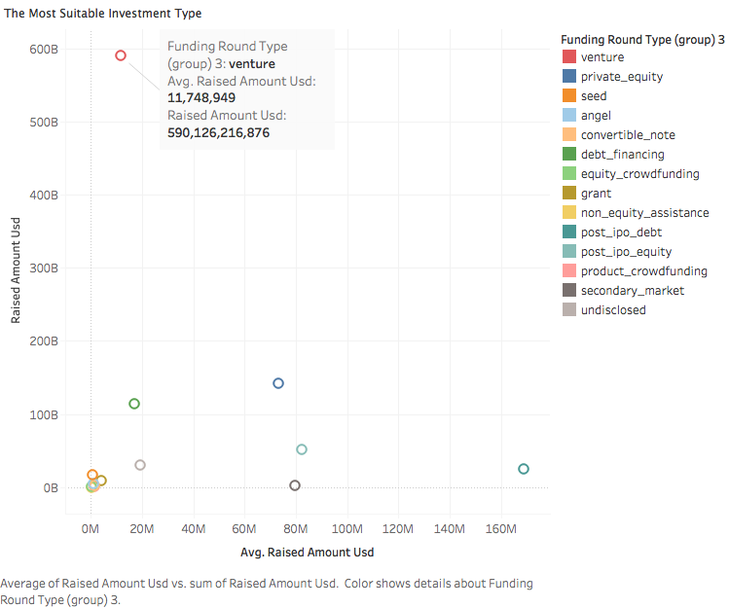
Investment Type Analysis
This scatter plot shows that venture investment (red circle) is the most suitable. The average investment is between $ 5 to $15 MM (x axis) and the total amount invested (y axis) is highest within that range.

Slide 8
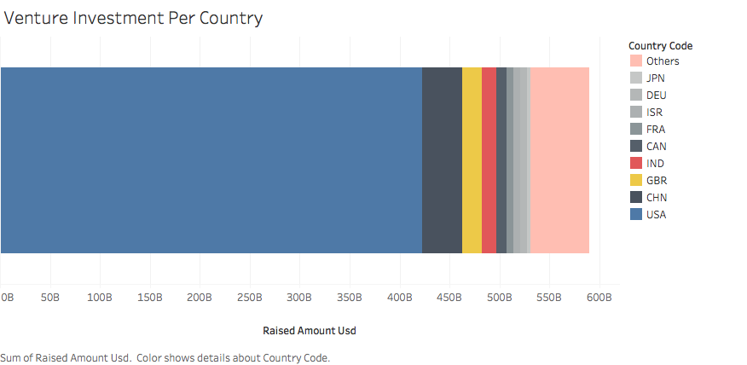
Country Analysis
The top 3 English speaking country are USA → Blue Great Britain →Yellow India → Red

Slide 9
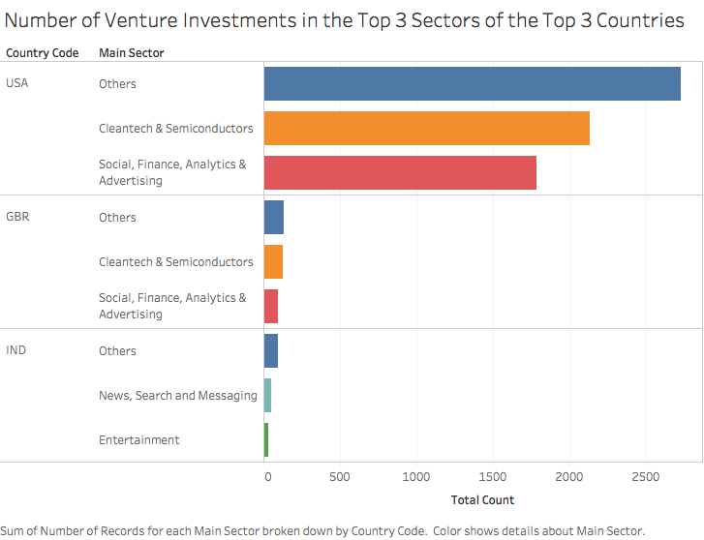
Sector Analysis

Slide 10
Recommendations for Spark Funds:
Investment type recommended is Venture
Investment countries recommended are:
USA
GBR
India
Top three investment sectors in each recommended country
USA
Other
Clean tech and Semiconductor
Social, Finance, Analytics and Advertising
GBR
Others
Cleantech and Semiconductor
Social, Finance, Analytics and Advertising
India
Others
News, search and messaging
Entertainment

